Slide 1
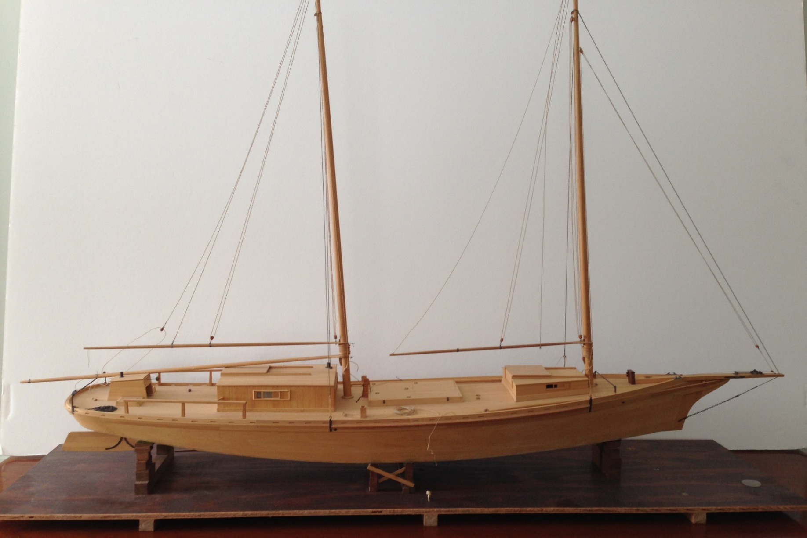
She Has Been Identified!

Slide 2
The Found Model
Lacy S, a member of Model Ship Wrights of Western NY, found her in a regional antique shop about 4 years ago
Purchased from his estate June 2020
Obviously a work boat
Flat bottom/athwart planked
Center Board
Auxiliary powered
Gaff rig (fore and main)
Mid ship cargo well
Unusual stern

Slide 3
The Found Model
Little luck at the time in identity
Skip Jack ? Bow resemblance; but twin mast, gaff rigged, motorized
Pungy? Bow resemblance; but stern not usually rounded, not flat bottomed
Bugeye? No
Sharpie? Bow resemblance
Posted on MSW; no strong leads
Lacy appealed to the Constitution ship modelers group; no results
Recently appealed to the Ship Modelers of New Jersey
Ryland Craze of both the NJ and Hampton Roads group offered help

Slide 4
The Found Model
Model is exquisitely executed
Apparently planked over bulkheads
Basswood construction, outstanding joinery
Simulated tree nailing
Scratch fittings, accurately and superbly done
Existing rigging, well done
Likely 1:24 scale ( approx. 28 inches long)
56 feet in LOA
12 foot beam
Needs minor repair/ replacement of parts

Slide 5
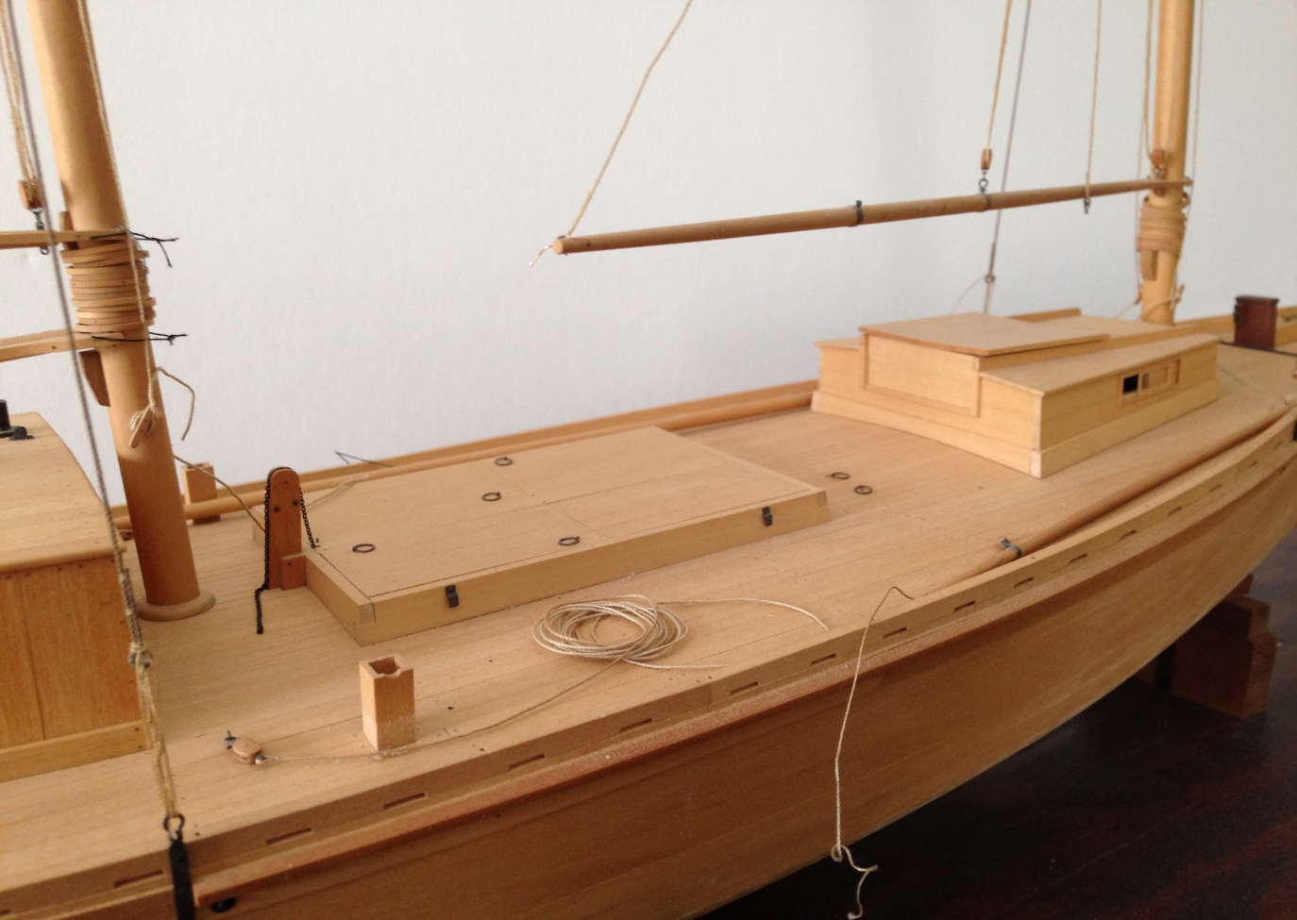
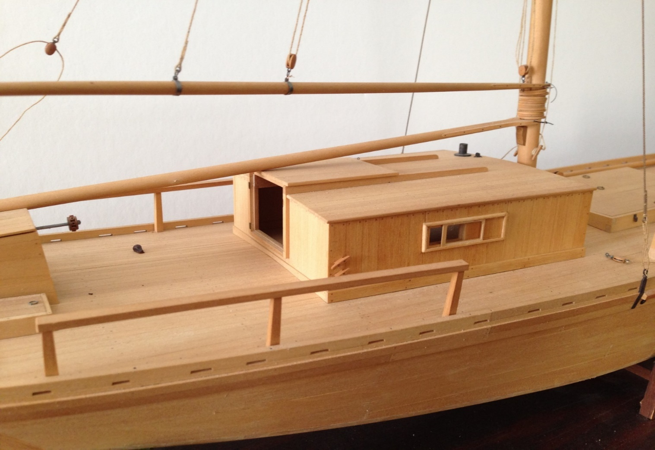
Main Deck House
Note the stack detail. It is even on the recently identified plan
Large Hatch, Forward Cabin

Slide 6
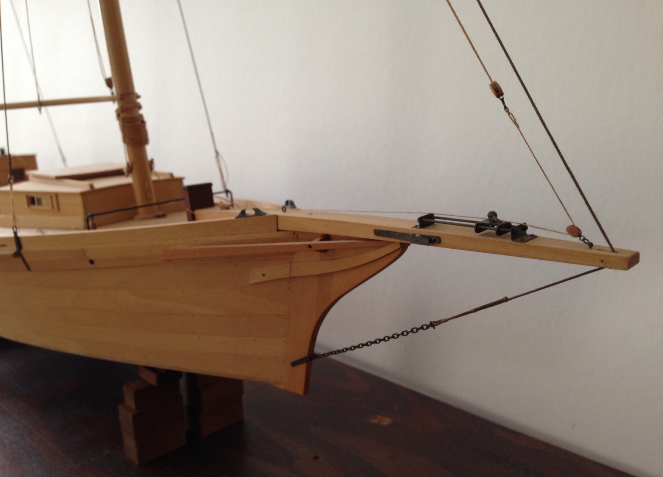
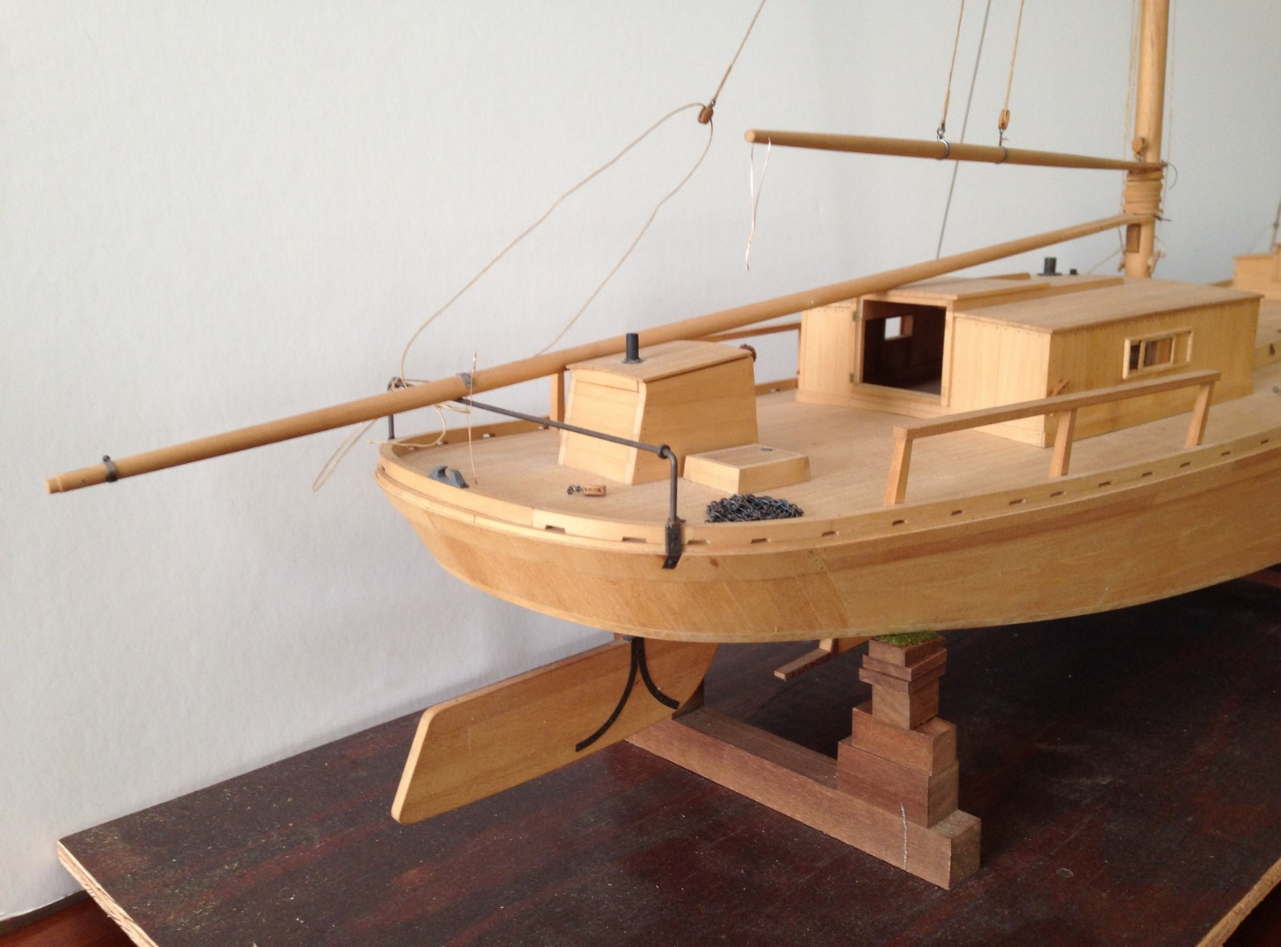
Skipjack like bow
Rounded Stern, Unusual Rudder
Note the uplift on the stern. More later

Slide 7
Model Built To Faithful Detail!
Hooray! Help received from Hampton Roads Model Group
Drawing referenced in Chapelle’s National Watercraft Collection
Built in West Palm Beach Florida for Spanish mackerel fishing
She is a Sharpie Fishing Schooner of 1899!
The very same stack detail
Note the stern uplift.

Slide 8
Restoration Tasks
New main cabin hatch, helm hatch cover,
Repair main hatch as it is falling apart
Fix the pilot house; missing ship’s wheel and missing hatch cover
Clean up and recoat model
Add furled sails
Deal with a few rigging needs
Build a proper stand and base
Make a case
Smithsonian drawing NWC- 48 (part of Chapelle collection) on the way

Slide 9
In Conclusion
About The Enduring Sharpie Design

Slide 10
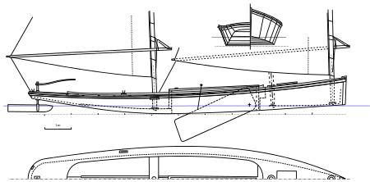
The Basic Sharpie Design!
Origin: the New England Sharpie (New Haven, Connecticut)
Hard chine, flat bottom, centerboard, fast craft, easy to build
Evolved along the Atlantic coast all the way to Florida
A design for shoal fishing (shallow draft, rounded and extreme uplift of stern and of course a center board, fore mast well forward)
Reference:https://sailcraftblog.wordpress.com/2016/06/26/pt-1-5-the-murky-history-of-the-sharpie/

Slide 11
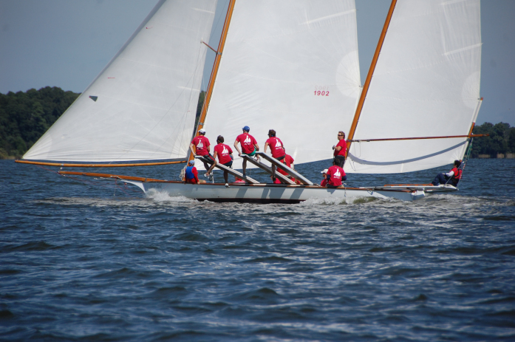
Evoluntioary Craft!
The racing Sharpie!
Same distinct lines
Just a different rig
Note the wish bone stern sail and stern perch!
Still popular today

Slide 12
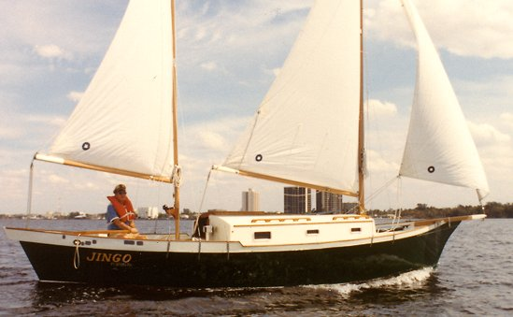
Evolved Into A Pleasure Craft!
A Sharpie Yacht!
Somewhat similar lines
Double ender stern though
Fore mast positioned farther back
Again easy to build

Slide 13
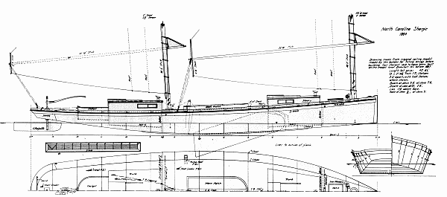
The Sharpie Work Craft!
North Carolina Sharpie
From the e book; THE MIGRATIONS OF AN AMERICAN BOAT Type; Howard Chapelle
Exact same lines, save no bow sprit and more forward fore mast

Slide 14
Conclusion: Just One Lament
Modeler unknown
The work of a master!
Deserves the recognition
Started a post of the restoration on MSW
Hoping for some leads on the modeler

